Slide 1
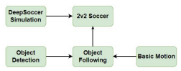
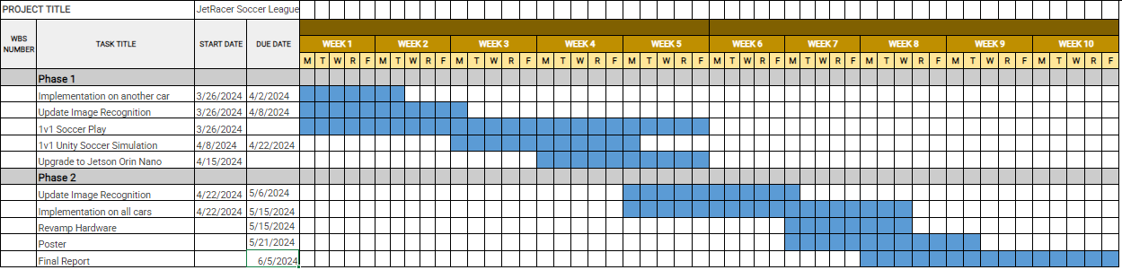
Overview
JetRacer Soccer Jarod Marshel, Casey Rittenhouse, Arjun Simha, Mason Kang, K Gupta, Julie Ham, Cooper Ritter
Overall Concept:
Overall Project Deliverable | Progress
Basic Movement | Done
Image recognition | Done
New sensor implementation | Done
Object following/Ball Striking | Done
Versus and Strategy | Done
Github with documentation | Done
Summary and report | Done
New Sensor
Project is On Schedule
Gantt Chart/Schedule

Slide 2
Short-Term
JetRacer Soccer Jarod Marshel, Casey Rittenhouse, Arjun Simha, Mason Kang, K Gupta, Julie Ham, Cooper Ritter
Previous Meeting Action Items:
Item | Description | Owner | Target Date | Status
1 | Build field for cars | Jarod | Feb 19 | Done
2 | Unity soccer simulation training | Mason | Jan 31 | Done
3 | Object following | Everyone | Mar 8 | Done
4 | Implement new sensor onto car | Everyone | Mar 11 | Done
5 | Preliminary Design Review | Everyone | Mar 12 | Done
6 | Retrain Object Detection | CV team | April 15 | Done
7 | 1v1 Soccer | Everyone | May 15 | Done
Biweekly Action Items:
Item | Description | Owner | Target Date | Status
1 | 1v1 Soccer Logic | Strategy Team | May 13 | Done
2 | Set up software on cars | ROS Team | May 15 | Done
3 | Upload ZED SDK and new weights to both cars | CV team | May 11 | Done
4 | Finalize Poster and Demo Video | Everyone | May 22 | Done
5
Significant Roadblocks/ Non-developing Items:
Budget:
Total Proposed | Plan to Date | Used to Date | Used Vs Plan
$3500 USD | $1450 USD | $650 USD | +$1400 USD
Short Term Schedule:
Request for teaching staff:
May |  |  |  |  |  |  |  |  |  | Feb
12 |  |  |  |  | 20 |  |  |  |  | 25
Finalize Poster
Finalize Project Demo

Slide 3
Team Progress

Slide 4
ROS/Strategy
JetRacer Soccer Jarod Marshel, Casey Rittenhouse, Arjun Simha, Mason Kang, K Gupta, Julie Ham, Cooper Ritter
Previous Work:
Tuning movement and strategy node switching
Finish poster
Future Work:
Smooth out last few bugs
Implement on second car
Record videos for demo
Write final report

Slide 5
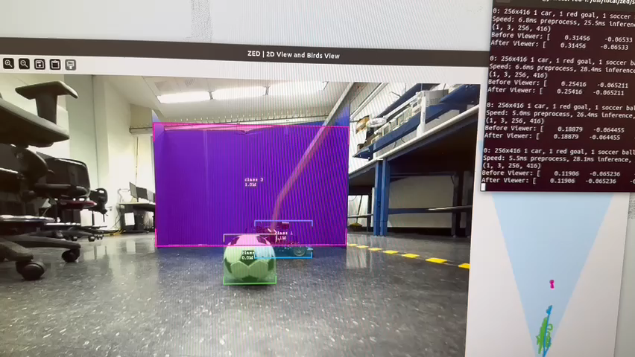
CV/Image Recognition (K and Julie and Jarod)
JetRacer Soccer Jarod Marshel, Casey Rittenhouse, Arjun Simha, Mason Kang, K Gupta, Julie Ham, Cooper Ritter
Previous Work:
Spent time this weekend trying to improve CV framerate
Navigated, uninstalled and installed a bunch of software dependencies for CUDA and Pytorch
Got detection code to use CUDA and brought framerate from 3 FPS to 15-20 FPS
Future Work:
Get all software on both cars
Test in field setup and take pictures for showcase
Finalize poster

Slide 6
Team Roles
Project Manager - Jarod
Point of Contact - Arjun
Budget Manager - Casey
ROS/Hardware Team:
Cooper, Arjun,
CV/Image Recognition Team:
K, Julie, Jarod
Software/Strategy Team:
Casey, Mason

Slide 7
Previous Year's Work
Built and gained full range of motion of 4 JetRacers using software
Set up a simulation environment to virtually train the agents
Structured a reward system for the reinforcement learning model
Implemented object detection model that identifies a soccer ball, opponent, and goal
Implemented software to follow and strike a ball
Developed logic process for striking a ball into a goal
Simulation results with reward structure demonstrate that agents can be trained to efficiently compete in a 2v2 soccer match
Created a GitHub page documenting the hardware and software instructions to setup JetRacers, a summary of the work completed, and plans for future work

Slide 8
Our Final Deliverables
Demonstrate basic motion of JetRacer: 01/2024
Demonstrate JetRacer Image Recognition for soccer play: 01/2024
Trade study of possible sensor additions: 02/2024
Preliminary Design Review: 02/2024
Showcase vehicle scoring soccer ball in the goal in real-world: 03/2024
Add additional agents in the real world: 04/2024
Final Data Review: 05/2024

